Slide 1
eMark UI Screenflow/Wireframe

Slide 2
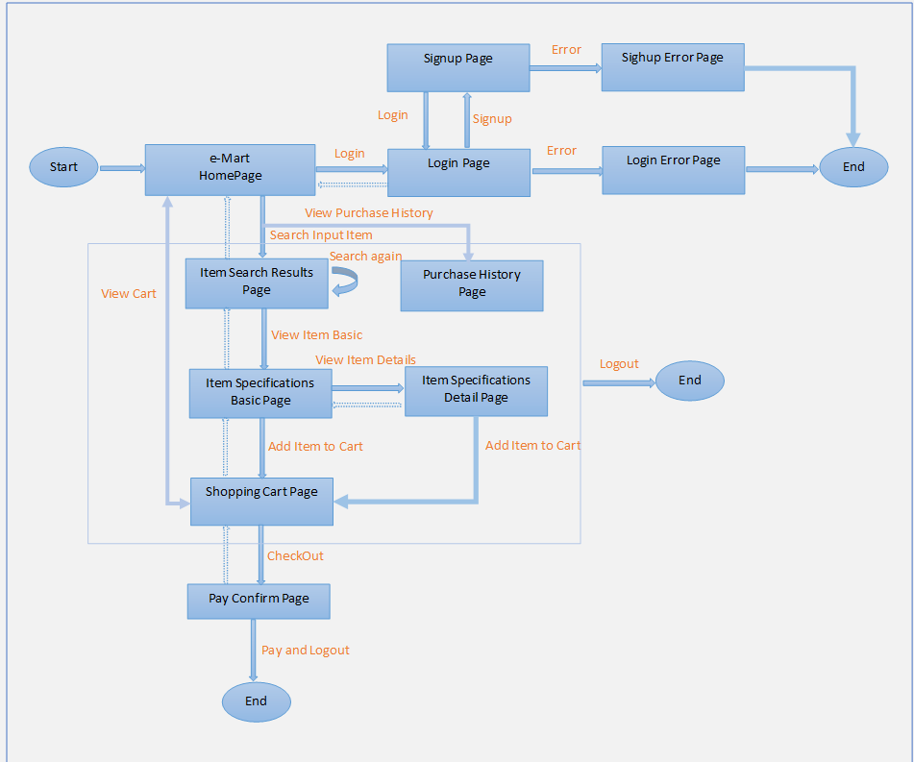
Buyer Screen Flow

Slide 3
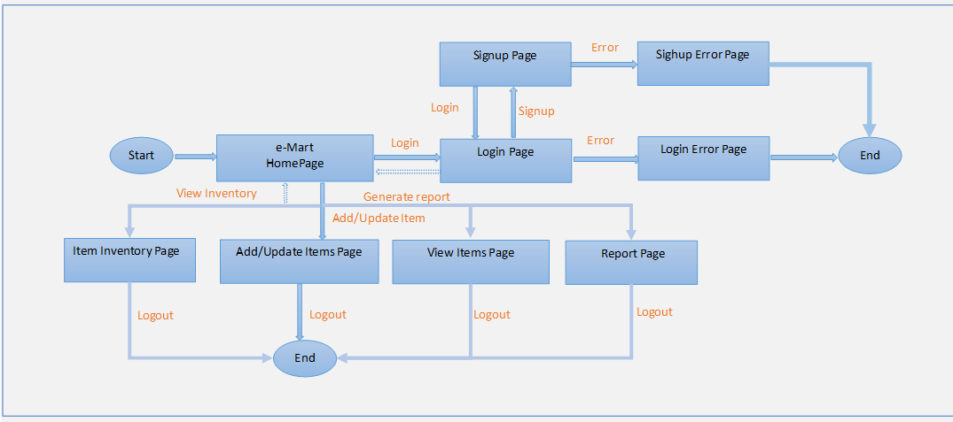
Seller Screen Flow

Slide 4
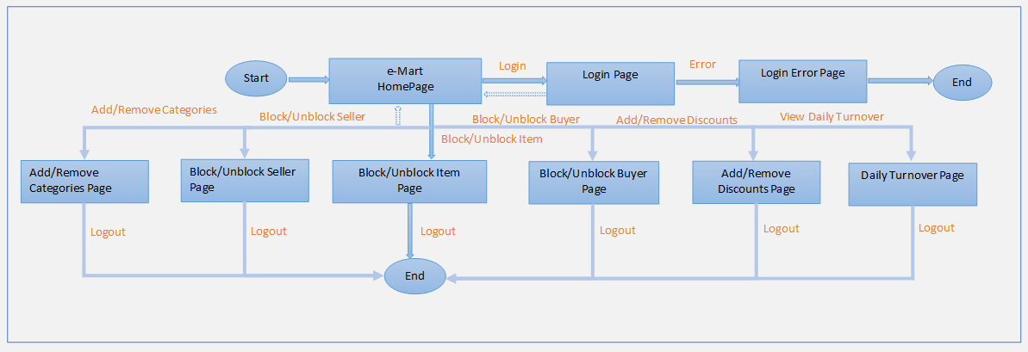
Admin Screen Flow

Slide 5
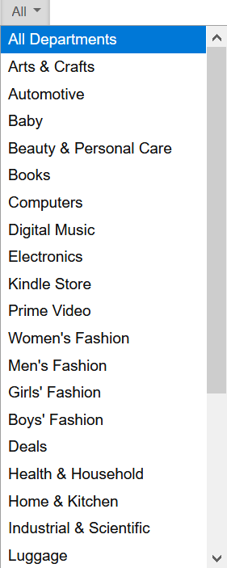
Buyer HomePage

Slide 6
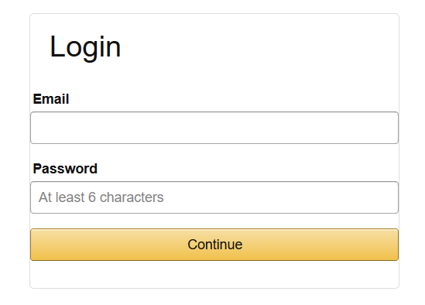
Buyer Login

Slide 7
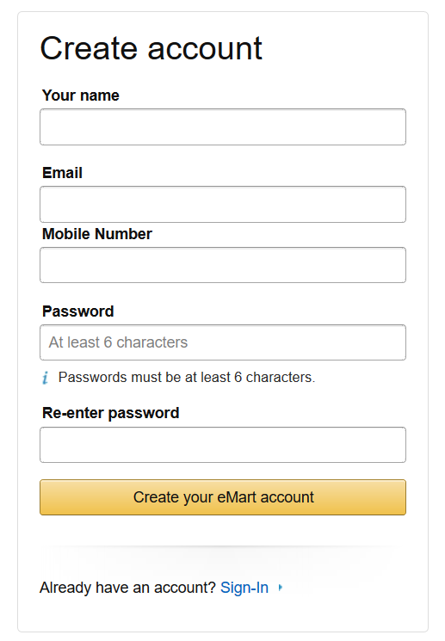
Buyer Signup

Slide 8
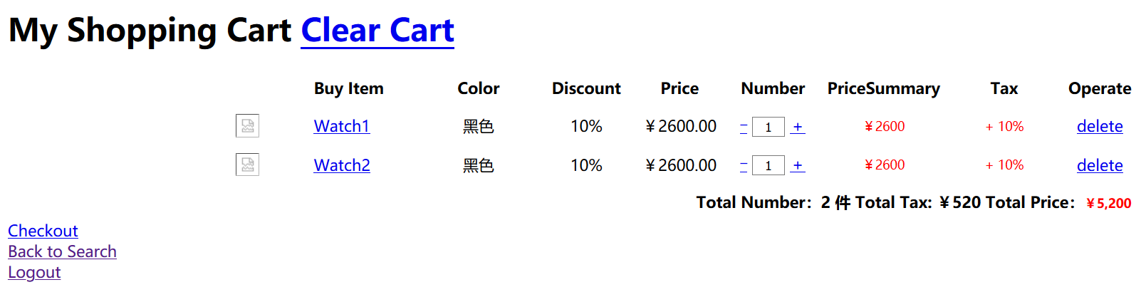
Buyer Shopping Cart

Slide 9
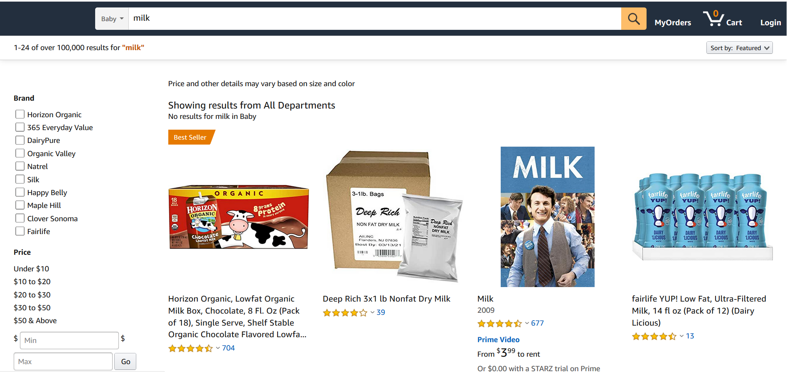
Buyer Item Search Results

Slide 10
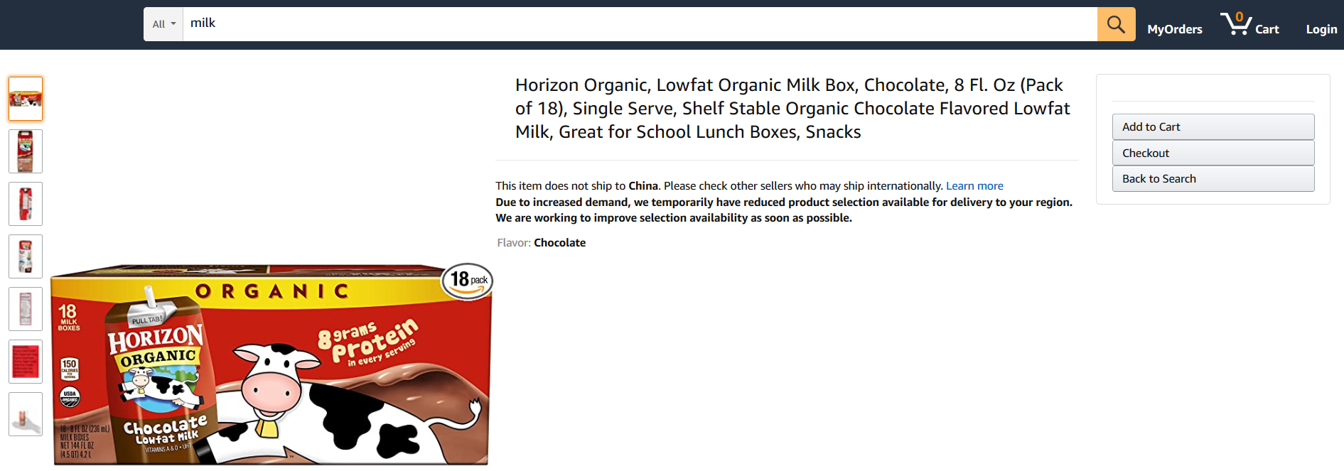
Buyer Item Specifications

Slide 11
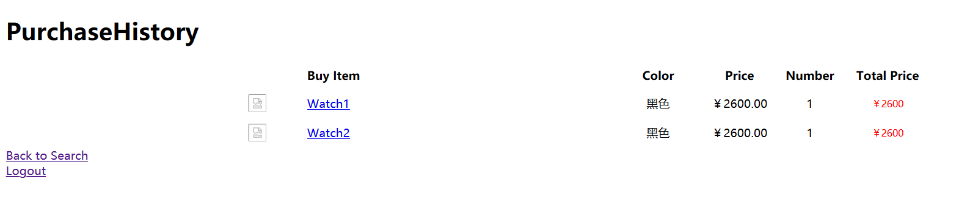
Buyer PurchaseHistory

Slide 12
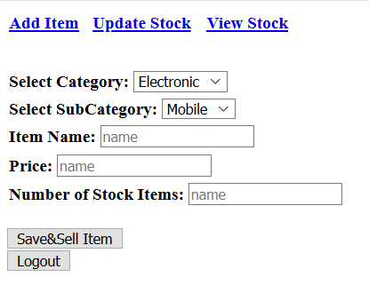
Seller Add Items

Slide 13
Other interface drawings to be continued

